Slide 1
ARRAYS
PRESENTED BY: Swetali Mohanty

Slide 2
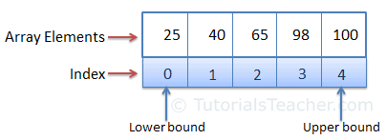
What is Array?
1. An array is a collection of elements of the same type that are referenced by a common name.
2. For example an array may contains all integer and character elements, but not both.
3. An array is a derived datatype.
4. An array index is always starts from the numerical value 0 and ends at 1 less than of the array index value.
5. For example an array[n] containing n number of elements are denotes by array[0] ,array[1]….array[n-1]. Where 0 is called lower bound and the n-1 is called the higher bound of the array.

Slide 3
Types of Arrays
Array can be categorized into different types. They are
One dimensional Array
Two dimensional Arrays
Multidimensional Arrays

Slide 4
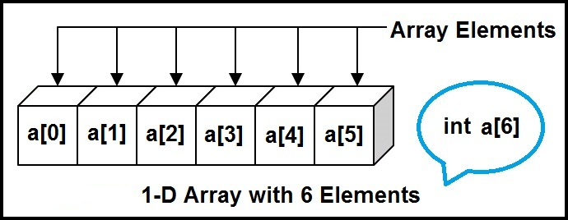
One Dimensional Array
A One-Dimensional Array is the simplest form of an Array in which the elements are stored linearly and can be accessed individually by specifying the index value of each element stored in the array.
Syntax: datatype array_name[size];

Slide 5
Declaration of One Dimensional Array
1. The general form of array declaration is type array_name [size].
2. Here the type specifies the data type of elements int the array ,such as int , float or char .
3. The size indicates the maximum numbers of elements that can be stored inside the array.
For example: int a[10]

Slide 6
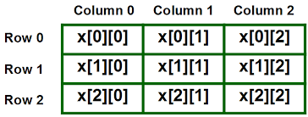
Two Dimensional Array
A two-dimensional array in C can be thought of as a matrix with rows and columns. The general syntax used to declare a two-dimensional array is:
Data_type name_of the array[rows][index];

Slide 7
Declaration of Two Dimensional Array
2D array can also be declared as an int, char, float, double, etc.
2D array declaration: datatype arrayVariableName[number of rows] [number of columns] int num[10][5];

Slide 8
Multi Dimensional Array
An array of arrays is called a multi-dimensional array. In simple words, an array created with more than one dimension (size) is called a multi-dimensional array. The multi-dimensional array can be of a two-dimensional array or three-dimensional array or four-dimensional array or more.
Syntax: type name[size1][size2]…[sizeN]; Example: int a[3][3][3];

Slide 9
Advantage of Array
1.Huge amount of data can be stored under single variable name.
2.In an array, accessing an element is very easy by using the index number.
3.The search process can be applied to an array easily.
4. Two dimensional array are used to represent the matrix.

Slide 10
Real life example and uses of array in daily life
Arrays are used to implement vectors, and lists in C++ STL. Arrays are used as the base of all sorting algorithms.
Arrays are used to implement other DS like a stack, queue, etc. Used for implementing matrice.
For example, if we wish to store the contacts on our phone, then the software will simply place all our contacts in an array.
2D arrays, commonly known as, matrices, are used in image processing.
It is also used in speech processing, in which each speech signal is an array.
Your viewing screen is also a multidimensional array of pixels.
Book titles in a Library Management Systems.
Online ticket booking.
To store images of a specific size on an android or laptop.

Slide 11

THANK YOU...

